Slide 1

STABILITY AND STABILIZATION OF NETWORKED LOAD FREQUENCY CONTROL SYSTEMS INTEGRATED WITH ELECTRIC VEHICLE AGGREGATORS.
Presented By:
Sharini Rithigaa B S (17CE153).
Gokulnath M (17EE111).
Kalavagunta Vamshi (17EE118).
Kalla Anil Sai Kumar (17EE119).
Under the guidance of, Dr. K.Ramakrishnan, M.E., Ph.D.,
Associate Professor,
Department of EEE.

Slide 2
INTRODUCTION:
Due to increasing environmental concerns, the gradual depletion of fossil resources and the increased penetration of highly variable renewable energy power generation, frequency control and stability are becoming more and more important.
Electric Vehicles (EVs) with vehicle to grid (V2G) technology have become a promising tool that can mitigate the intermittent effects of renewable energy sources and regulate the system frequency.
EVs can quickly adjust the power output as compared with conventional generators. This quick response characteristics increases the dynamic performance of LFC generators.

Slide 3
For practical participation of EVs in frequency regulation market, entity called EV aggregator is required to aggregate and control a large number of EVs to satisfy frequency regulation.
Electric Vehicle Aggregator’s main function is to send and receive information regarding the charging status of EV’s in order to adjust their power output using an automatic generation control.
Load Frequency control (LFC) systems aim to regulate the frequency and to keep the scheduled tie-line power exchange in an interconnected power system with independently controlled multiple areas.

Slide 4
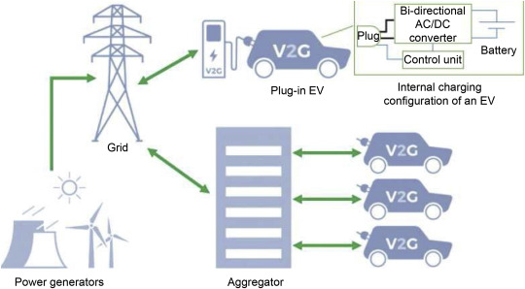
Fig 1. Integration of Electric Vehicle Aggregator to grid.

Slide 5
AN OVERALL GLANCE:
Whenever there is heavy power demand or power shortage the frequency of the voltage between the tie lines connecting Electric vehicle aggregator and smart grid reduces.
This reduction in frequency is sensed through sensor and the information is sent to information center by PI controller.
According to the level of reduction in frequency, the PI controller decides how much input of power to be extracted from the Electric Vehicle Aggregator.
Here, the Electric Vehicle Aggregator acts as source of power to compensate the demand of power along with the Smart Grid.

Slide 6
LITERATURE SURVEY:
This project deals with computation of communication time delays on stability regions and stability delay margins of the PI controller between the Electric Vehicle Aggregator and the smart grid of a single area load frequency control(LFC) system.
A graphical method of characterizing stability boundary locus is implemented.
For a given time delay, the method computes all the stability gains of PI controller, which constitutes a stability regions in parameters of space of PI controller.
Later a frequency domain exact method is used to calculate stability delay margins for various values of PI controller gains.
The complete analysis is made in order to pass the information of error in the system within the stability margin delay to bring the system to equilibrium point.

Slide 7
OBJECTIVES OF PROJECT:
To access the impact of integrating electrical vehicle aggregator on stability of single area load frequency control system.
The integration of geographically dispersed electric vehicle aggregator through communication network introduces time delay in closed loop control system.
The presence of time delay in feedback loop of the closed loop load frequency control system affects performance and stability of the system.
In this presentation, a methodology is presented to assess the maximum allowable bound of time delay within which the networked load frequency control system stays stable.

Slide 8
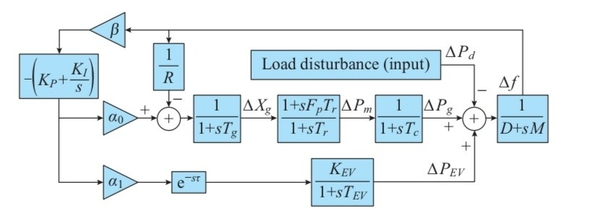
LFC SYSTEM MODEL WITH EV AGGREGATOR:
Fig. 1. System model of single-area LFC with EV aggregator.

Slide 9
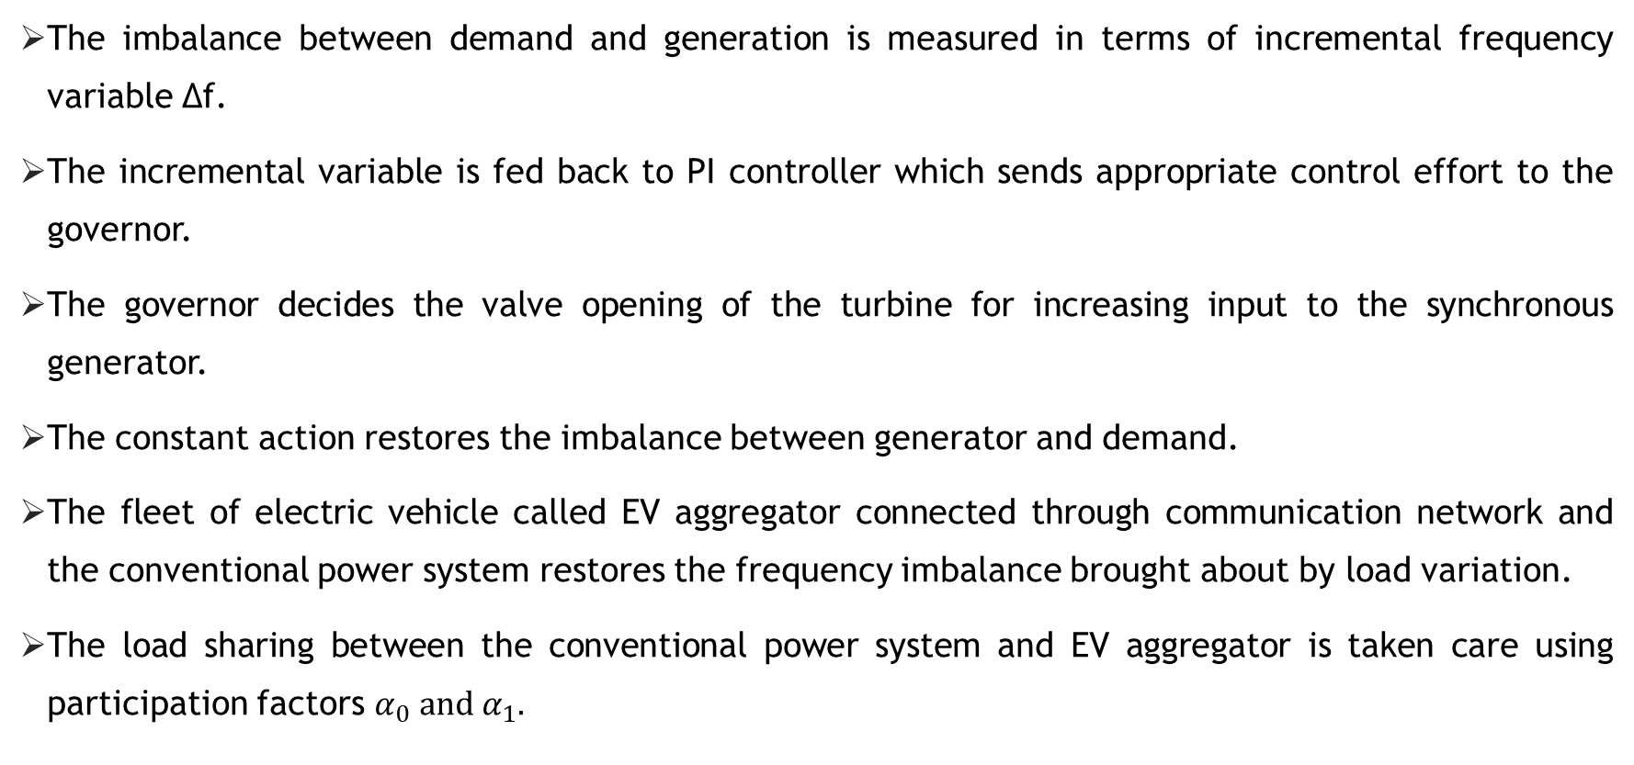
SYSTEM DESCRIPTION:
The imbalance between demand and generation is measured in terms of incremental frequency variable ∆f.
The incremental variable is fed back to PI controller which sends appropriate control effort to the governor.
The governor decides the valve opening of the turbine for increasing input to the synchronous generator.
The constant action restores the imbalance between generator and demand.
The fleet of electric vehicle called EV aggregator connected through communication network and the conventional power system restores the frequency imbalance brought about by load variation.
The load sharing between the conventional power system and EV aggregator is taken care using participation factors $α_{0} and α_{1}.$

Slide 10
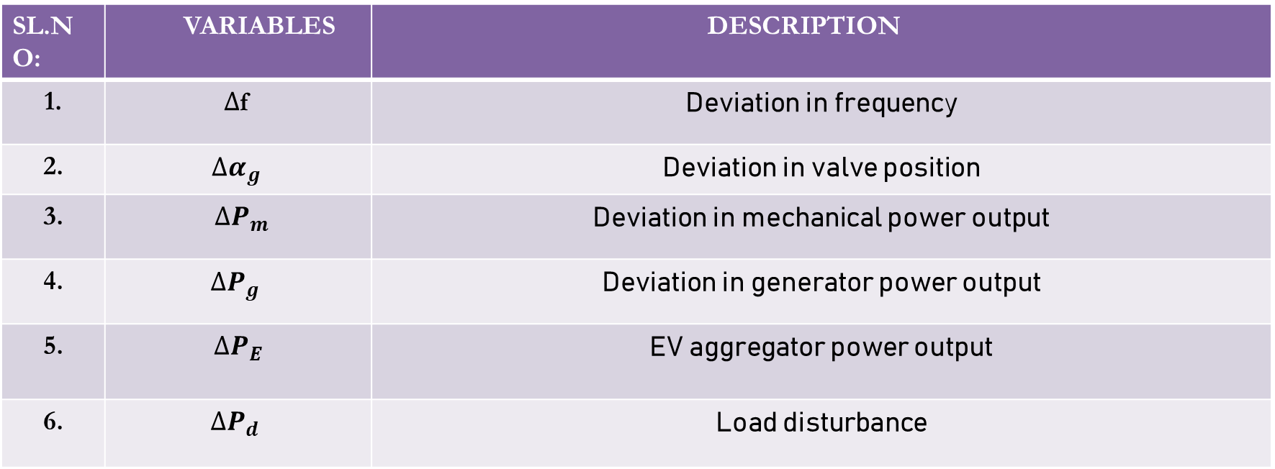
DESCRIPTION OF VARIABLES :
SL.NO: | VARIABLES | DESCRIPTION
1. | $∆$f | Deviation in frequency
2. | $$∆α_{g}$$ | Deviation in valve position
3. | $∆P_{m}$ | Deviation in mechanical power output
4. | $$∆P_{g}$$ | Deviation in generator power output
5. | $$∆P_{E}$$ | EV aggregator power output
6. | $$∆P_{d}$$ | Load disturbance

Slide 11
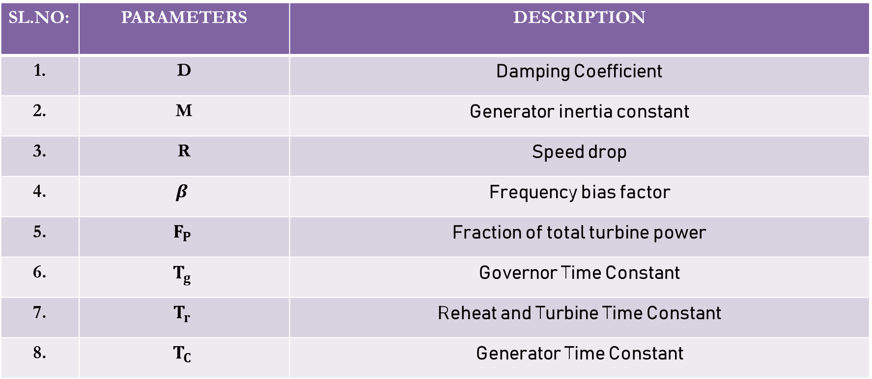
DESCRIPTION OF PARAMETERS:
SL.NO: | PARAMETERS | DESCRIPTION
1. | D | Damping Coefficient
2. | M | Generator inertia constant
3. | R | Speed drop
4. | $$β$$ | Frequency bias factor
5. | $$F_{P}$$ | Fraction of total turbine power
6. | $$T_{g}$$ | Governor Time Constant
7. | $$T_{r}$$ | Reheat and Turbine Time Constant
8. | $$T_{C}$$ | Generator Time Constant

Slide 12
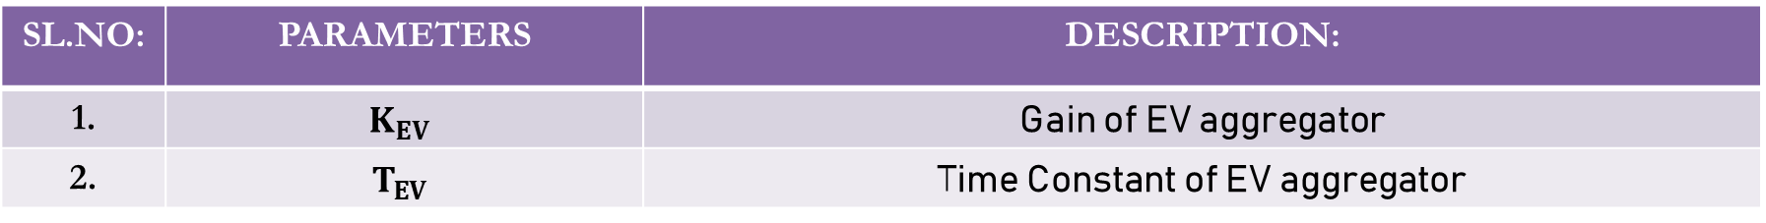
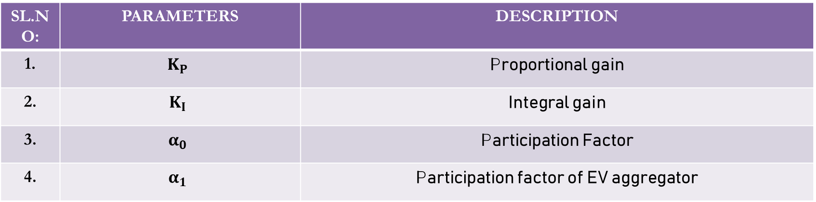
CONTROLLER PARAMETERS AND PARTICIPATION FACTORS:
SL.NO: | PARAMETERS | DESCRIPTION
1. | $$K_{P}$$ | Proportional gain
2. | $$K_{I}$$ | Integral gain
3. | $$α_{0}$$ | Participation Factor
4. | $$α_{1}$$ | Participation factor of EV aggregator
PARAMETERS OF ELCTRIC VEHICLE AGGREGATOR:
SL.NO: | PARAMETERS | DESCRIPTION:
1. | $$K_{EV}$$ | Gain of EV aggregator
2. | $$T_{EV}$$ | Time Constant of EV aggregator
Communication Delay is given by e^{-sτ}

Slide 13
DELAY DEPENDANCY STABILITY:
The characteristic equation has delay term e^{-sτ} in it. Hence, system stability depends on time delay τ.
For a satisfactorily designed PI controller, with τ = 0, all the closed-loop poles are in the LHS of S plane.
With increase in network τ, a pair of complex conjugate poles exhibits a tendency to move towards jω axis.
When time delay τ equals a critical delay value called stable delay margin τ*
the closed loop system has one pair of purely imaginary poles on jω axis. At this
condition, the system is at the verge of instability.
The objective of the stability analysis to compute τ*, the maximum allowable delay bound that guarantees marginal stability.
For τ > τ*, the closed loop system becomes unstable.

Slide 14
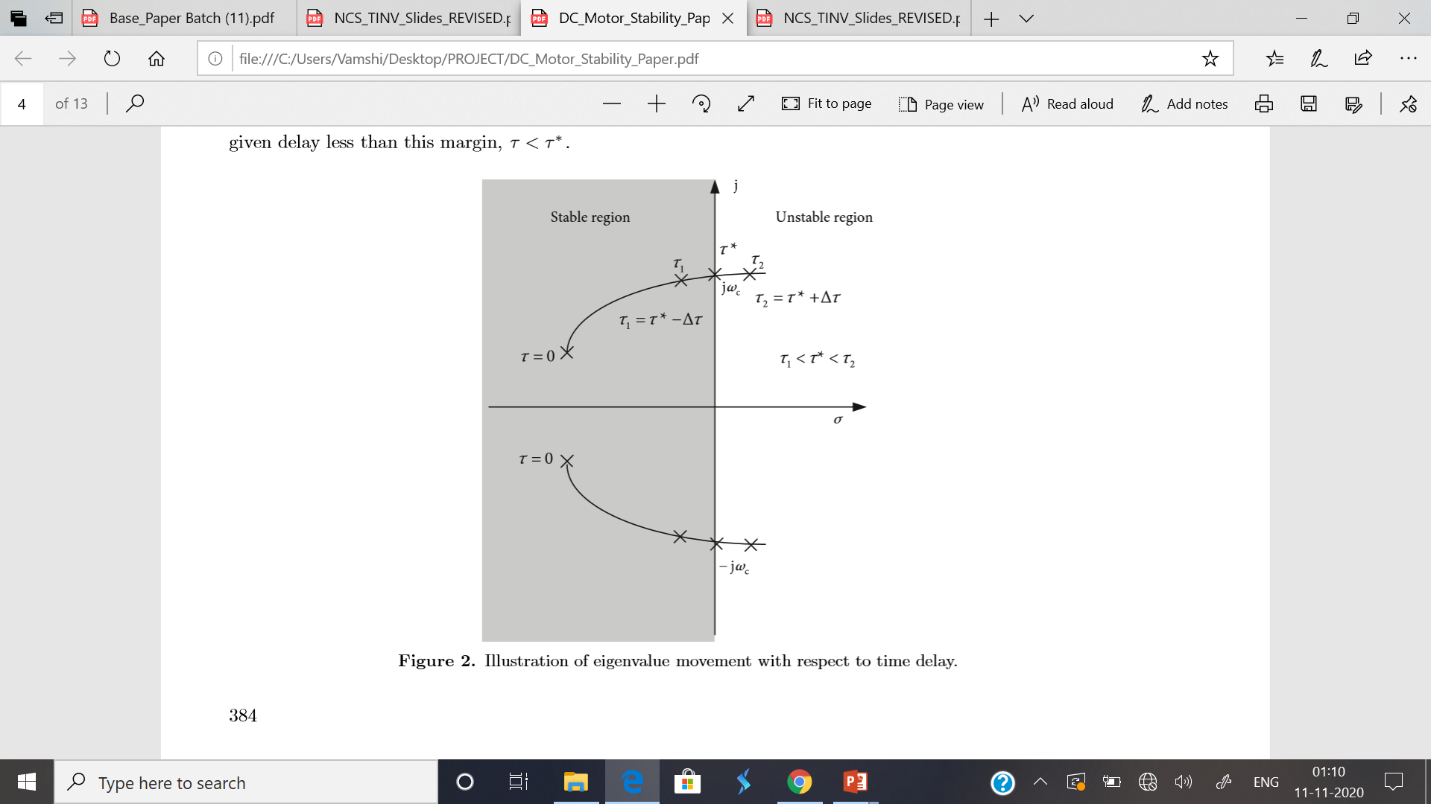
DELAY DEPENDANCY STABILITY:

Slide 15
FLOWCHART:
START
Inputs the parameters of LFC system
Obtain the characteristic equation of the closed
loop system as P(s) + Q(s) e^{-sτ}
Solve the equation ω(ω_{c}²)=0, and obtain the roots
ω_{c}² ,K; where K=1,2,..…m
Set i=1; j=0
A

Slide 16
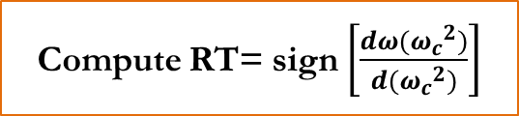
A
NO
Is i<=m;
YES
τ* =min(τ_{j})
Is ω_{c}²,i real?
Stop
NO
YES
NO
Is ω_{c}²,i >0 ?
A
i = i+1
Compute ω_{c} , i
Compute RT= sign $\left[\frac{dω({ω_{c}}^{2})}{d({ω_{c}}^{2})}\right]$
NO
Is
RT=+1
YES
B

Slide 17
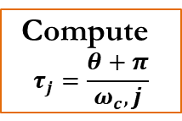
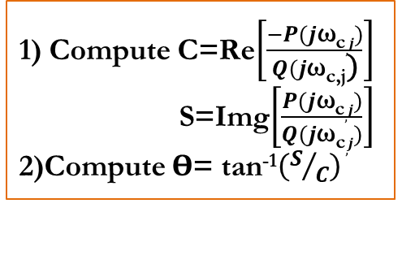
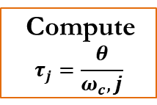
B
Set j = j+1
1) Compute C=Re$\left[\frac{−P(j\text{ω}\text{c},j)}{Q(j\text{ω}\text{c}\text{,}\text{j}\text{)}}\right]$
S=Img$\left[\frac{P(j\text{ω}\text{c},j)}{Q(j\text{ω}\text{c},j)}\right]$
2)Compute ϴ= tan⁻¹$\left(S/C\right)$
YES
Is ϴ<0
NO
Compute
$$τ_{j}=\frac{θ+π}{ω_{c},j}$$
Compute
$$τ_{j}=\frac{θ}{ω_{c},j}$$
i = i+1
A

Slide 18
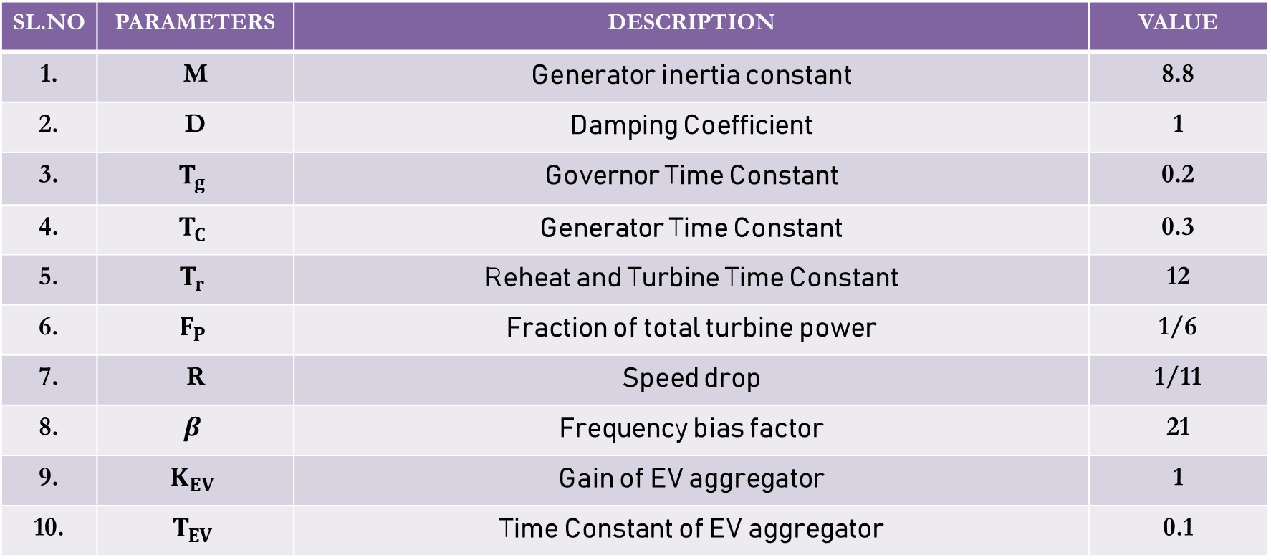
BENCHMARK SYSTEM PARAMETERS:
SL.NO | PARAMETERS | DESCRIPTION | VALUE
1. | M | Generator inertia constant | 8.8
2. | D | Damping Coefficient | 1
3. | $$T_{g}$$ | Governor Time Constant | 0.2
4. | $$T_{C}$$ | Generator Time Constant | 0.3
5. | $$T_{r}$$ | Reheat and Turbine Time Constant | 12
6. | $$F_{P}$$ | Fraction of total turbine power | 1/6
7. | R | Speed drop | 1/11
8. | $$β$$ | Frequency bias factor | 21
9. | $$K_{EV}$$ | Gain of EV aggregator | 1
10. | $$T_{EV}$$ | Time Constant of EV aggregator | 0.1

Slide 19
DELAY DEPENDANT STABILITY MARGIN:
$τ^{∗}$ - STABILITY DELAY MARGIN (s)
K_{p} | K_{I}=0.2 | K_{I}=0.4 | K_{I}=0.6 | K_{I}=0.8 | K_{I}=1.0
0 | 1.7866 | 0.4231 | 0.0859 | -0.0615 | -0.1417
0.1 | 2.7421 | 0.8271 | 0.3496 | 0.1340 | 0.0134
0.2 | 3.5861 | 1.2002 | 0.6018 | 0.3242 | 0.1656
0.3 | 4.2522 | 1.5214 | 0.8327 | 0.5034 | 0.3115
0.4 | 4.6970 | 1.7773 | 1.0346 | 0.6669 | 0.4477
0.5 | 4.8537 | 1.9635 | 1.2023 | 0.8108 | 0.5717
0.6 | 4.6817 | 2.0829 | 1.3339 | 0.9327 | 0.6812
0.7 | 4.3135 | 2.1433 | 1.4300 | 1.0317 | 0.7751
0.8 | 3.9050 | 2.1545 | 1.4932 | 1.1080 | 0.8527
0.9 | 3.5197 | 2.1273 | 1.5275 | 1.1628 | 0.9142
1.0 | 3.1740 | 2.0715 | 1.5372 | 1.1982 | 0.9606

Slide 20
PENDING WORKS FOR PHASE 1:
To carry out time-domain simulation studies to validate the stability delay margin obtained in previous table.
Documentation of the works carried out in this semester.

Slide 21
CONCLUSION:
In this project a single area LFC system integrated with EV aggregator over a communication network is considered for stability analysis.
The closed-loop transfer function of the LFC system with EV aggregator and network induced time delay is derived.
The delay-dependent stability analysis is done to compute the stable delay margin for various sub-set of the PI controller parameters.
A standard benchmark system was employed in the stability analysis and stable delay margin was obtained.
It is planned to conduct extensive simulation studies to validate the analytics results in coming days.

Slide 22
BASE PAPER AND REFERENCES:
Ausnain Naveed, Sahin Sonmez and Saffet Ayasun, ‘Impact of Electric Vehicle Aggregator with Communication Time Delay on Stability Regions and Stability Delay Margins in Load Frequency Control System,’ Journal of Modern Power Systems and Clean Energy, In Press. DOI: 10.35833/MPCE.2019.000244, 2020, Springer. (BASE PAPER)
Hakan Gunduz, Sahin Sonmez and Saffet Ayasun, ‘Impact of Electric Vehicles Aggregator on the Stability Region Micro-Grid System with Communication Time Delay,’ 2019 IEEE Milan Power Tech.
Vijay P. Singh, Nand Kishor, and Paulson Samuel, ‘Communication Time Delay Estimation for Load Frequency Control in Two Area Power Systems,’ Ad Hoc Networks, Vol. 41, No. 1, pp. 69-85, May 2016.
Ausnain Naveed, Sahin Sonmez and Saffet Ayasun, ‘Stability Regions in the Parameter Space for LFC System with EV Aggregator and Incommensurate Time Delays,’ 1st IEEE Global Power Energy and Communication Conference (GPECOM 2019), June 12-15, 2019, Cappadocia, Turkey.
Han, Y., Zhang, K., Hong, L., Coelho, E. A. A., and Guerrero, J. M, ‘MAS-based Distributed Coordinated Control and Optimization in Microgrid and Microgrid Clusters: A Comprehensive Overview.’ IEEE Transactions on Power Electronics, Vol. 33, No. 8, pp. 6488-6508, 2018.

Slide 23
6) H. Luo, I. A. Hiskens and Z. Hu, ‘Stability Analysis of Load Frequency Control Systems With Sampling and Transmission Delay,’ IEEE Transactions on Power Systems, Vol. 35, No. 5, pp. 3603-3615, Sept. 2020
7) K. S. Ko and D. K. Sung, ‘The Effect of EV Aggregators With Time-Varying Delays on the Stability of a Load Frequency Control System,’ IEEE Transactions on Power Systems, Vol. 33, No. 1, pp. 669-680, Jan. 2018
8) Deniz Katipoglu, Sahin Sonmez and Saffet Ayasun, ‘Stability Delay Margin Computation of Load Frequency Control System with Demand Response,’ 1st IEEE Global Power Energy and Communication Conference (GPECOM 2019), June 12-15, 2019, Cappadocia, Turkey.

Slide 24
THANK YOU!!!

